Slide 1
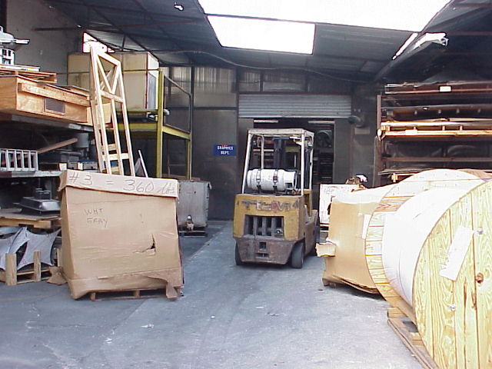
Managing Safety and Health, Overview
Ron Hopkins, CFPS, CFEI
TRACE Fire Protection and Safety Consultants. Ltd.
Richmond, Kentucky

Slide 2
Section Objectives
Upon successful completion of this section, each participant will be able to:
1. Discuss the costs of accidents and the benefits of safety and health programs.
2. Describe the OSHA requirements and guidelines for safety and health programs in general industry.

Slide 3
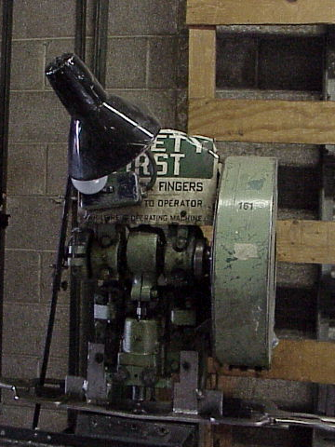
I. Introduction
Research indicates benefits to companies who establish effective worker safety and health programs:
  Reduction in the extent and severity of work-related injuries and illnesses
  Improved employee morale
  Higher productivity
  Lower workers’ compensation costs

Slide 4
A. Exemplary Workplaces
Common characteristics of effective safety and health programs:
  Assignment of responsibility to managers, supervisors, and workers
  Regular inspections to control hazards
  Employee training and orientation for the recognition and avoidance of hazards

Slide 5
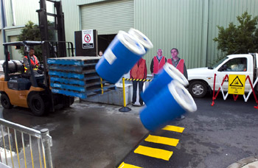
B. Cost of Accidents
1. 45 billion dollars
2. 3.9 million lost workdays (average 20 days)
3. 1 out of 20 will suffer serious injury or illness
4. Pain and suffering
5. Damage to environment
6. Morale of employees

Slide 6
C. Cost of Accidents
Direct Accident Costs
Indirect Accident Costs

Slide 7
Cost of Accidents
1. Direct Accident Costs
Medical (30% increase)
Insurance premiums (30% increase)
Employee compensation (long term)
Long term cost (medical / legal)
Loss of Credibility with workforce
Legal and medical cost

Slide 8
Cost of Accidents
2. Indirect Costs
  Equipment/material
  Replacement cost
  Overtime pay
  Lost sales
  Hire and train new employees
  Investigate accident
  Worker’s compensation
  Clean up
  Repair damaged area
Loss of Credibility with workforce
Legal and medical cost

Slide 9
D. Causes of Accidents and Illnesses
Accidents / Illnesses
Hazardous
Acts
Hazardous
Conditions
Unaware
Unable
Unmotivated
Unidentified
Uncorrected

Slide 10
Proactive
Safety and Health
Management
H. W. Heinrich’s Theory
Fatal
Major Injury
Property/Injury
Minor Property
Near Miss

Slide 11
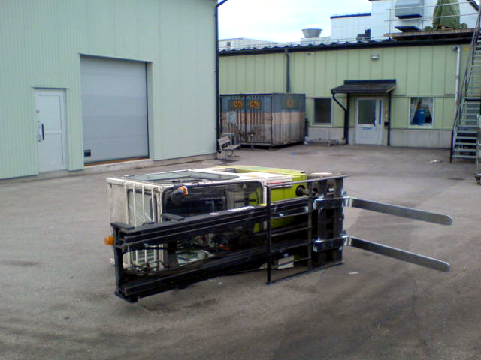
1. Fatalities
4,547 workers died on the job in 2010
14 Fatalities
August 12 to
October 5, 2011*
Source: www.osha.gov/dep/fatcat/fatcat_weekly_rpt_10082011.html 12/7/2011

Slide 12
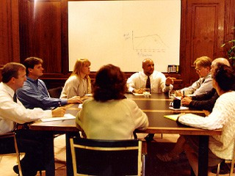
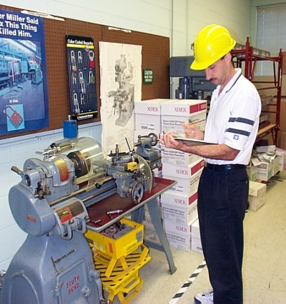
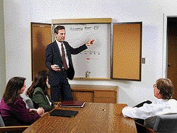

II. Safety and Health Programs
Notes:
This presentation is designed to assist trainers conducting OSHA 10-hour General Industry outreach training for workers. Since workers are the target audience, this presentation emphasizes hazard identification, avoidance, and control – not standards. No attempt has been made to treat the topic exhaustively. It is essential that trainers tailor their presentations to the needs and understanding of their audience.
This presentation is not a substitute for any of the provisions of the Occupational Safety and Health Act of 1970 or for any standards issued by the U.S. Department of Labor. Mention of trade names, commercial products, or organizations does not imply endorsement by the U.S. Department of Labor.

Slide 13
A. S & H Program Guidelines
Systematic approach to hazard:
  Identification
  Evaluation
  Control

Slide 14
S & H Program Guidelines
As the size of the workplace increases so does the need for a formalized written program
Program effectiveness more important than “In Writing”
Elements taken from the ‘Safety and Health Program Guidelines - 1989’

Slide 15
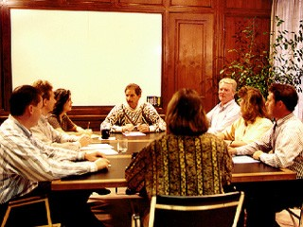

B. Major Elements
An effective occupational safety and health program includes the following four elements:
    Management commitment and employee involvement
    Worksite analysis
    Hazard prevention and control
    Safety and health training
Notes:
The best Safety and Health Programs involve every level of the organization, instilling a safety culture that reduces accidents for workers and improves the bottom line for managers.
What are the common characteristics of a safety and health culture?
Management believes that safety and health on the job is as important a company goal as other organizational objectives, such as cost control, quality, and productivity.
Individuals within the organization believe they have a right to a safe and healthy workplace.
- Each person accepts personal responsibility for ensuring his or her own safety and health.
- Everyone believes he or she has a duty to protect the safety and health of others.

Slide 16
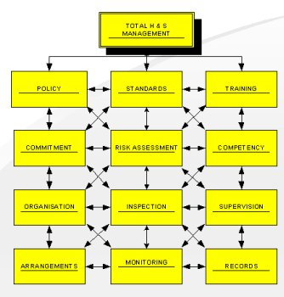
1. Management Commitment
Policy and Goals
Clearly state a worksite safety
and health policy
Establish and communicate a clear goal and objective for the safety and health program
Involve top management in implementing the program

Slide 17
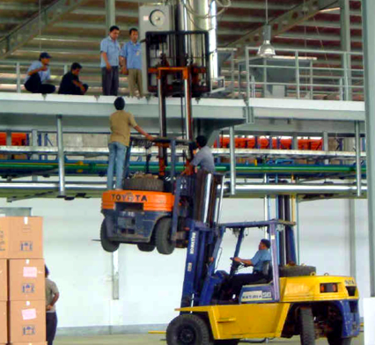
2. Employee Involvement
Encourage employees to get involved in the program and in decisions that affect their safety and health
Communicate responsibility for all program aspects
Notes:
Employees must commit to safety and health protection for themselves and fellow workers.
Examples: inspection or hazard analysis teams; developing or revising safe work rules; training new hires or co-workers; assisting in accident investigations.

Slide 18
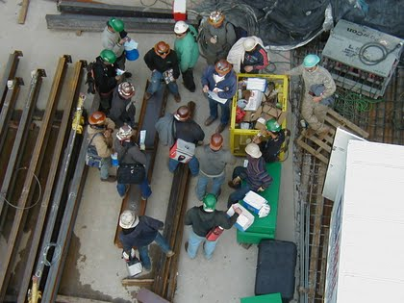
3. Responsibility
Parties responsible for the
  safety and health program
  must have authority and resources
Managers, supervisors, and employees must be held accountable for meeting their responsibilities
Program operations must be reviewed at least annually, to evaluate, identify deficiencies, and revise, as needed

Slide 19

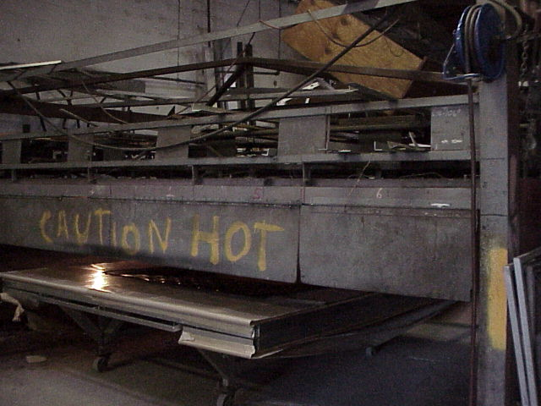
4. Worksite Analysis
Examine the worksite and identify:
  existing hazards
  conditions and operations where changes might occur to create hazards
Management must actively analyze the work and the worksite to anticipate and prevent harmful occurrences
Notes:
Management must provide the resources and authority so all personnel can find the hazards in the worksite and, once found, eliminate or control those hazards.

Slide 20

5. Comprehensive Survey
  Conduct a comprehensive baseline survey for safety and health
    Hazard and Risk Assessment
    Job Task Analysis
    Job Safety Analysis
Notes:
Job Hazard Analysis (JHA)
This involves studying and recording each step of a job, identifying existing or potential job hazards and determining the best way to perform the job to reduce or eliminate hazards. Jobs that were initially designed to be safe may change over time so they have hazards or require unsafe operations. Job safety analysis should form a base for the comprehensive survey. It includes analyzing planned and new facilities, processes, materials, and equipment.
-- See Publication #3071, Job Hazard Analysis
OSHA’ s Consultation Service
For small businesses, OSHA-funded, state-run consultation services can conduct a comprehensive survey at no cost. Many workers’ compensation carriers and other insurance companies offer expert services to help their clients evaluate safety and health hazards. Larger businesses may find the needed expertise at the company or corporate level.
-- See www.osha.gov/oshprogs/consult.html for more information
Industrial hygiene survey: at a minimum, all chemicals and hazardous materials in the plant should be inventoried, the hazard communication program should be reviewed, and air samples analyzed. For many industries, a survey of noise levels, a review of the respirator program, and a review of ergonomic risk factors are needed.

Slide 21

6. Safety and Health Inspections
Conduct regular
(usually weekly) site
inspections
Establish daily work
area inspection procedures
Develop and use a checklist
Provide a reliable system for employees, without fear of reprisal, to notify management about apparent hazardous conditions and to receive timely and appropriate responses
Notes:
Routine site safety and health inspections are designed to catch hazards missed at other stages. This type of inspection should be done at regular intervals, generally on a weekly basis. In addition, procedures should be established that provide a daily inspection of the work area.
You can use a checklist already developed or make your own, based on:
- Past problems
- Standards that apply to your industry
- Input from everyone involved
- Your company's safety practices or rules
Important things to remember about inspections are:
- Inspections should cover every part of the worksite
- They should be done at regular intervals
- In-house inspectors should be trained to recognize and control hazards
- Identified hazards should be tracked to correction
Information from inspections should be used to improve the hazard prevention and control program.

Slide 22
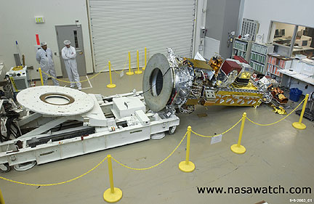

7. Additional Worksite Analysis
Investigate accidents and “near miss” incidents, so that their causes and means for prevention are identified
Analyze injury and illness trends, so that common cause patterns can be identified and prevented
Notes:
Six key questions should be answered in the accident investigation and report: who, what, when, where, why, and how. Thorough interviews with all involved are necessary. The primary purpose of the investigation is to prevent future occurrences. Therefore, the results of the investigation should be used to initiate corrective action.
Review of the OSHA injury and illness forms is the most common form of pattern analysis, but other records of hazards can be analyzed for patterns. Examples are inspection records, workers’ compensation claims, and employee hazard reporting records.

Slide 23
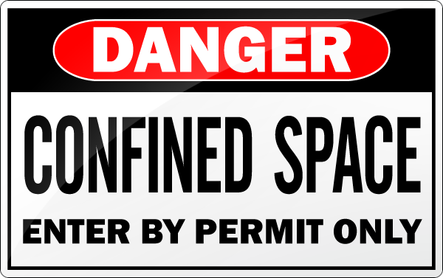
8. Hazard Prevention and Control
Start by determining that a hazard or potential hazard exists
Where feasible, prevent hazards by effective design of job or job site
If the hazard cannot be eliminated, use hazard controls
Eliminate or control hazards in a timely manner
Notes:
OSHA Safety & Health Management Systems eCat
This eCAT (electronic Compliance Assistance Tool) will help you review and evaluate key aspects of your Safety and Health Program, if you have one. If you do not have one, it could help you think about elements of a good program. It is straightforward and very easy to use.
OSHA invites you to try out this tool, and welcomes your comments and suggestions.
http://www.osha-slc.gov/SLTC/safetyhealth_ecat/index.html

Slide 24
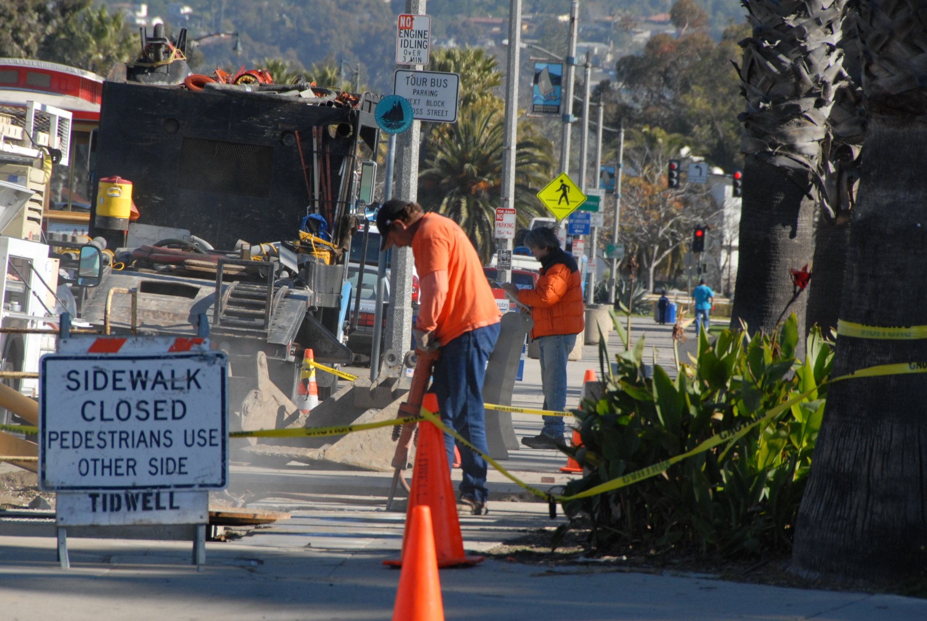
9. Safety and Health Training
Safety is a Skill!
Notes:
Engineering controls Where feasible and appropriate, the first and best strategy is to control the hazard at its source. Engineering controls do this, unlike other controls that generally focus on the employee exposed to the hazard. The basic concept is that the work environment and the job itself should be designed to eliminate hazards or reduce exposure to hazards.
Administrative Controls Includes exercise breaks and rotation of workers. These types of controls are normally used in conjunction with other controls.
Personal Protective Equipment PPE is a supplementary method of control via clothing or equipment when hazard exposure cannot be engineered completely out, and when other forms of control cannot provide sufficient additional protection. Remember, PPE is the last level of control!
Safe Work Practices Include your company’s general workplace rules and other operation-specific rules. For example, even when a hazard is enclosed, exposure can occur when maintenance is necessary.

Slide 25
Essential Elements of an
Effective Safety and Health Program
Management Commitment and Employee Involvement
Worksite Analysis
Hazard Prevention and Control
Effective Safety and Health Training

Slide 26
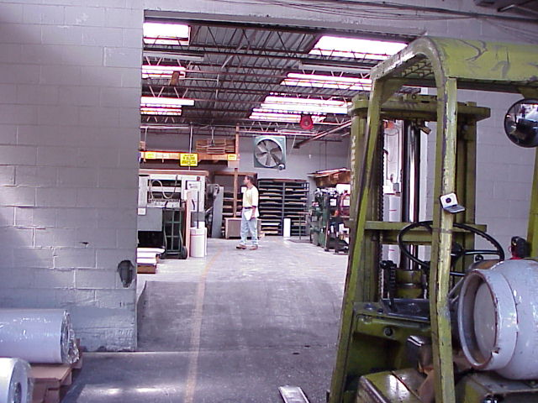
Managing Safety and Health, Overview
Questions?
Ron Hopkins, CFPS, CFEI
Instructor, EKU OSHA Ed Center
Eastern Kentucky University

